Slide 1

Project Scope
HAPPYTOHELP is a Web Application which provides home services(Electrician Services) to the Customers. The main purpose behind this application is to manage Customer Bookings & allows CUSTOMER to book an appointment From the comfort of their homes, and at any time.

Slide 2
No formal knowledge is needed for the user to use this application. Thus by this it proves it is user-friendly application. HAPPYTOHELP application, as described above, can lead to error free, secure, reliable and fast management system.

Slide 3
HappyToHelp web application is having following features :
1.Login/Registration
2.Booking Management
3.Feedback/Rating Management
4.Service Management

Slide 4
Development Tools details :
Tool | Version | Use
Spring tool suite 4 | 4.13.0.RELEASE | Backend
VS Code Editor | 1.60.0 | Front end
MySql | 8.0.27 | Database
Web browser(chrome) | Version 92.0.4515.159 (Official Build) (64-bit) | UI Testing
Git | git version 2.31.1.windows.1 | Version control

Slide 5
Development Technologies :
Technology | Version | Use
Java | java version "1.8.0_291" | Development ( Controller , Model )
HTML | HTML5 | View Pages
CSS | CSS3 | Style sheets
Java_Script | v14.17.1 | DOM manipulation , Dynamic Response
BootStrap | Bootstrap v5.1.0 | Resposiveness to Device
SpringBoot | 2.5.4 | Backend Framework
Hibernate | 5.4.21.Final | ORM tool

Slide 6
1st Module : Customer And Vendor Registration
Customer Registration:
1. Customer Registration form.
2. Customer Information.
3. Submission.
4. Registration Successful.
Vendor Registration:
1. Vendor Registration form. 2. Document upload.
2. Vendor Information.
3. Submission.
4. Registration Successful .

Slide 7
2nd Module : Booking Management
1. Customer Login.
2. View Customer Profile.
3. Search Services.
4. Book Services.
5. View Booking Status / Booking Service. 6. Give Feedback.
7. Logout.

Slide 8
4th Module : Feedback / Review management
1. Admin login.
2. View Feedback.
3. Update Ratings wise feedback on Vendor's Profile.
4. Logout.

Slide 9
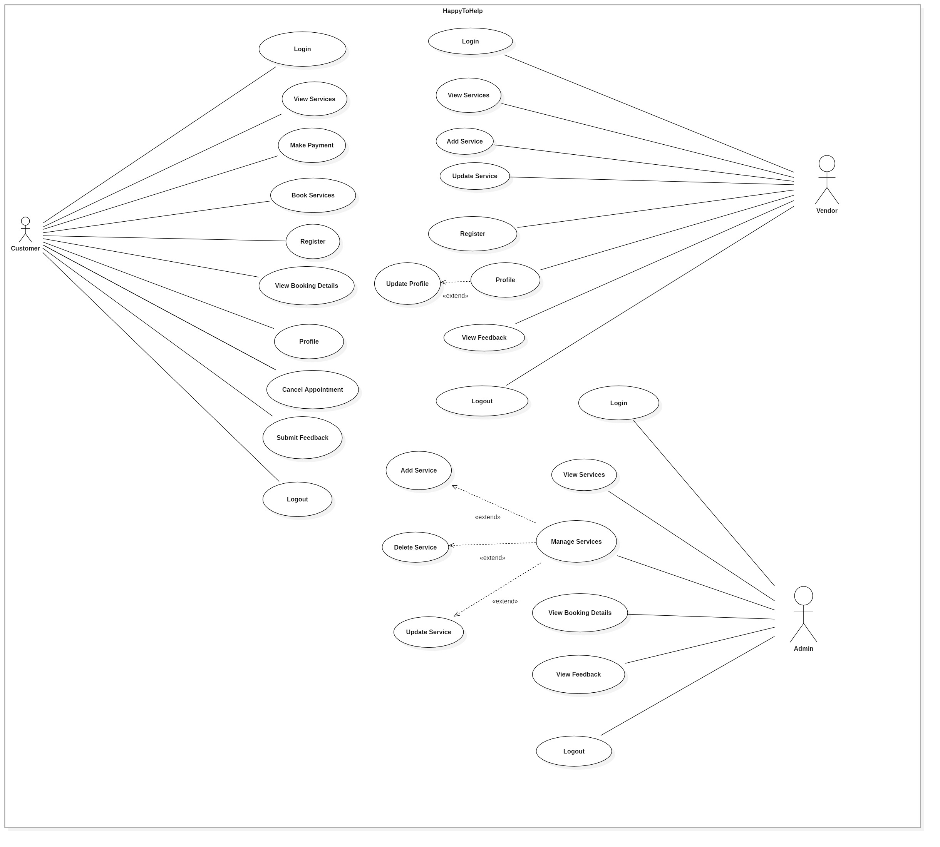

Slide 10
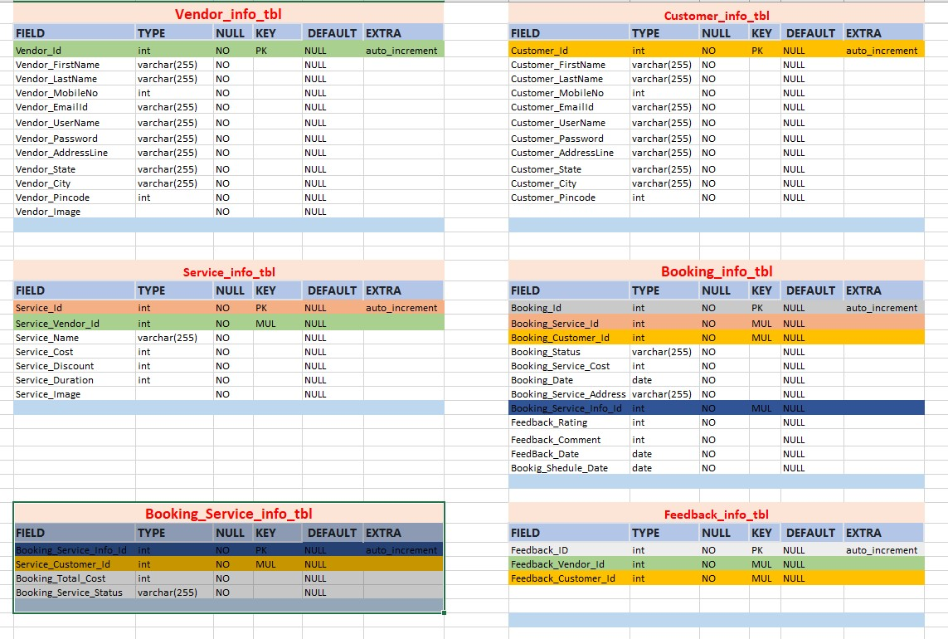
HappyToHelp-Project-DBSchema :

Slide 11

Index page :

Slide 12
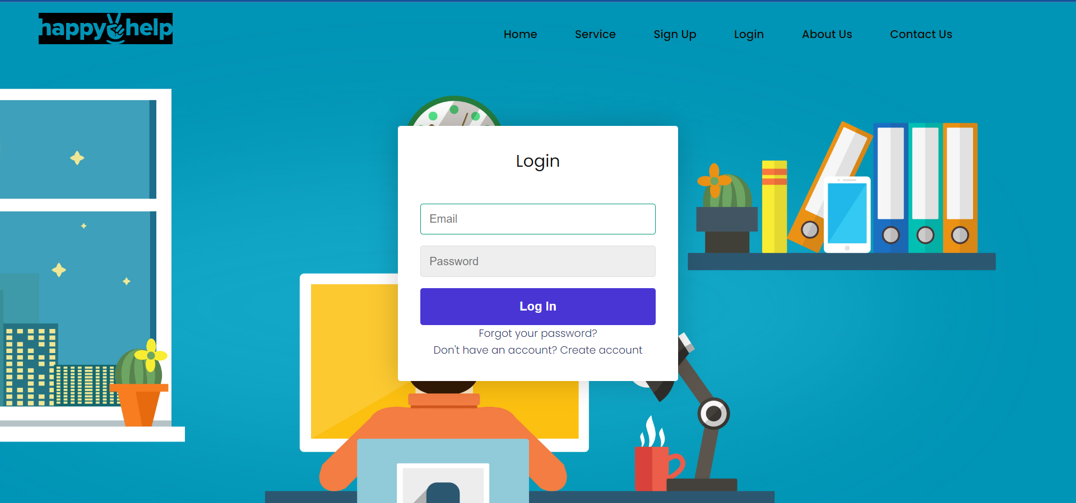
Login page :

Slide 13
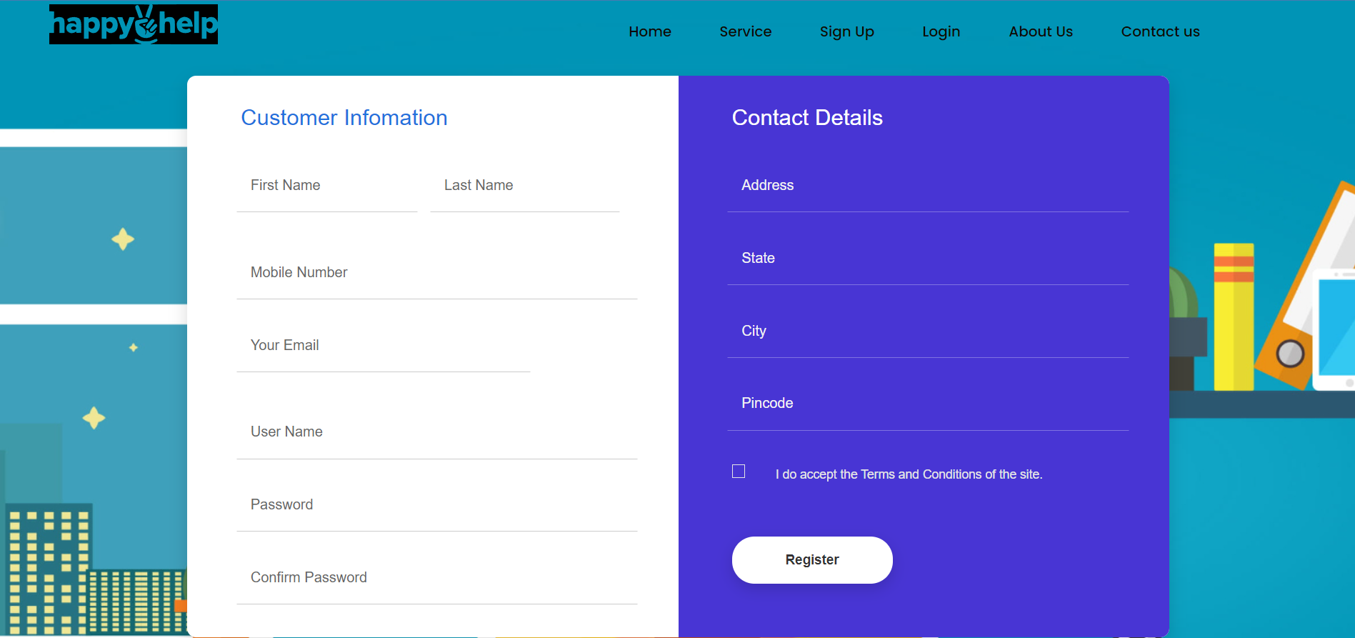
Registration page :

Slide 14
Thank you!!

